Slide 1
Programming the Humanities
Or: Should All Humanities Students Learn to Program?
Rudy McDaniel
UCF Texts and Technology Program
THATCamp 2013

Slide 2
Kirschenbaum’s Argument
Hello Worlds (2009), Chronicle of Higher Education: http://chronicle.com/article/Hello-Worlds/5476.
Programming is:
  A type of world building
  Empirical, but not objective
  Essential for teaching procedural literacy
Is this the contemporary equivalent of learning a foreign language?

Slide 3
Languages and the Humanities
A foreign language requirement has long been considered a cornerstone of a liberal arts education (right?)
What do foreign languages require students to do?

Slide 4
Side Effects and Benefits
In addition to the obvious benefits of speaking and writing a new language, this process also teaches students to:
  Understand new syntactical and semantic structures for dealing with language
  Develop more nuanced understanding of audiences and relevant discourse patterns
  Recognize common word patterns
  Work out new tactics for communication in various contexts

Slide 5
Does Coding Teach These Things?
Understand new syntactical and semantic structures for dealing with language | Programming structure and language-specific syntax requirements (variables, type, scope, iteration, conditional logic, etc.)
Develop more nuanced understanding of audiences and relevant discourse patterns | Rule-based, specific, unambiguous
Recognize common word patterns | Common functions and built-in data structures
Work out new tactics for communication in various contexts | Logic and organizational requirements for various types of languages (e.g., imperative vs. object-oriented)

Slide 6
Rules, Models, and Algorithms
“I believe that, increasingly, an appreciation of how complex ideas can be imagined and expressed as a set of formal procedures — rules, models, algorithms — in the virtual space of a computer will be an essential element of a humanities education. Our students will need to become more at ease reading (and writing) back and forth across the boundaries between natural and artificial languages. Such an education is essential if we are to cultivate critically informed citizens — not just because computers offer new worlds to explore, but because they offer endless vistas in which to see our own world reflected.”
http://chronicle.com/article/Hello-Worlds/5476

Slide 7
Programming as a Creative and Generative Activity
“Many of us in the humanities think our colleagues across the campus in the computer-science department spend most of their time debugging software. This is no more true than the notion that English professors spend most of their time correcting people's grammar and spelling. More significantly, many of us in the humanities miss the extent to which programming is a creative and generative activity.”

Slide 8
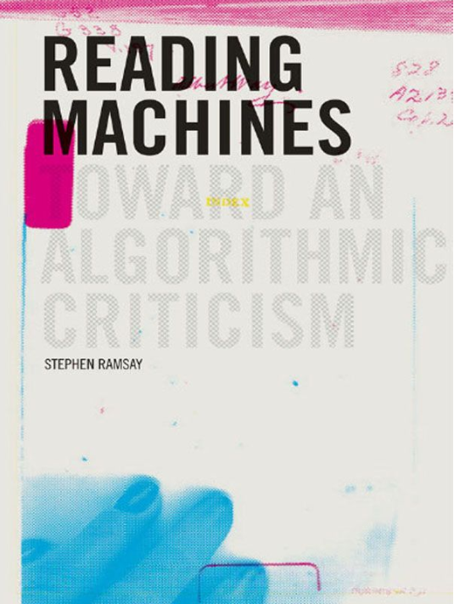
Algorithmic Criticism
Reading Machines by Stephen Ramsay
“If algorithmic criticism is to have a central hermeneutical tenet, it is this: that the narrowing constraints of computational logic– the irreducible tendency of the computer toward enumeration, measurement, and verification—is fully compatible with the goals of criticism set forth above.” (speaking of “the humanistic propensity toward disagreement and elaboration.”)

Slide 9
My Own Perspective
As a humanities professor, I’m fascinated by:
  The theoretical possibilities afforded by the idea of algorithmic criticism from a humanistic perspective
  New models and possibilities for storytelling enabled by new, creative aesthetic and interactive structures
As an applied researcher and practitioner, I’m encouraged by:
  The number of free and accessible programming language environments that are now available
  The various affordances of these new development environments
  The potential for digital humanists to create, employ, and disseminate new tools specific for their own research

Slide 10
Some Thoughts on Building vs. Using
Snobbery or elitism on either side is not particularly useful
Skills in building are useful for coding, and skills in coding are useful for building
At some point, your creative vision and research goals may not be fully realizable using someone else’s tools

Slide 11
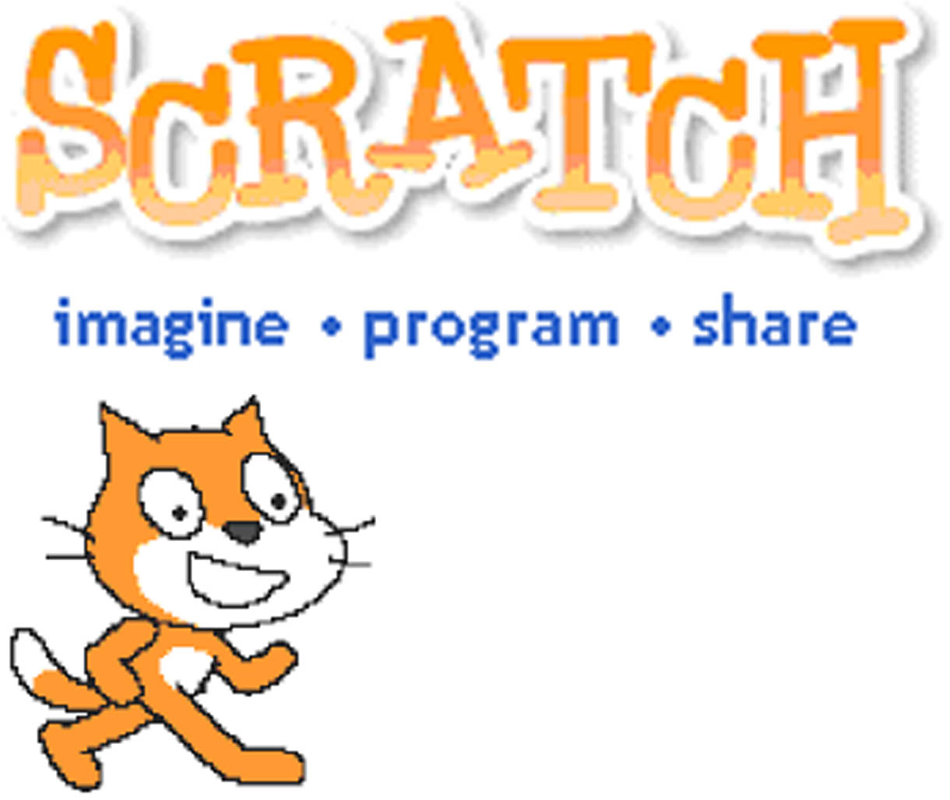
Example Languages
Scratch
Processing
PHP
Python
Ruby

Slide 12
Discussion / Yakk Prompts
What are the particular needs of digital humanists working in different fields (in terms of tools and software)?
Where do extant tools break down and how would you extend (or how have you extended) existing tools to better allow you to pursue your research?
Do you know how to program? If so, what was your pathway to learning this skill?
If you code, what were some of the most valuable tips and lessons you learned while acquiring this skill?
What are some of the non-programming skills digital humanities practitioners should be aware of?
Where do you stand on (or what do you think of) the “users vs. builders” debate?

Slide 13
Needs of Humanities Students
How do they store their research? Need to know a little about databases.
How do they ask the right questions? Ask the right questions before they run to a particular tool.
When do they need to program, vs. when do they need to do other things? What is the role of planning and preparation?
How do constraints come into play?

Slide 14
What tools are they currently using?
AppBuilder
Excel
Zotero
Omeka
Oxygen
XTF

Slide 15
What do they need?
Cohorts with multidisciplinary skills
  Maybe start at the graduate level?
  Schedule a course at the same time, then combine.
Workbench – humanities research center (physical space with resources)
Starter projects
Longitudinal projects (ala SourceForge)

Slide 16
Usefulness of Programming
Teaching logic to humanities students
Robert Cummings, rhetorical triangle
10 print chr(255+….)
Why do we learning languages in the humanities? To read texts that are not yet translated. (Montfort et al.)
Having to learn German as a PhD student. A “character building moment?”

